Slide 1

The High Costs of Living and the Problems that Follow.
Darick cochrane

Slide 2


Why it’s Important to me.

Slide 3
Research Questions
Cost of Living
Housing Costs
Earned Wages
Covid
How will Future Generations be Affected
Schooling

Slide 4

Current Knowledge

Slide 5
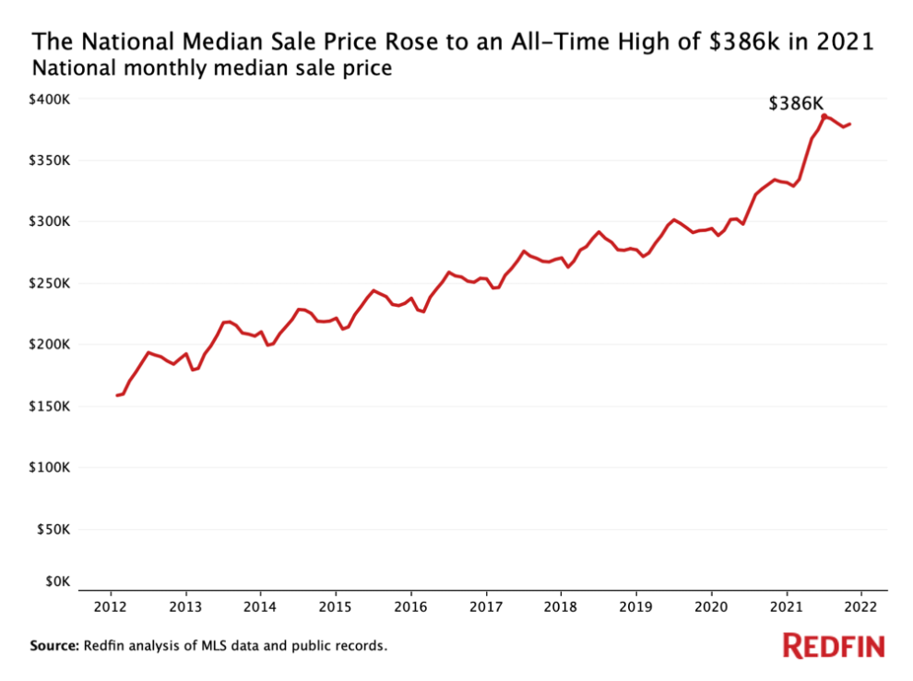


Slide 6
10 Years
2011-2012
In 2012, iPhone 5 was released.
Average rent in 2011 was $845.
2021
. Average rent in 2021 was $1,164
37% increase over 10 years – Follows inflation.

Slide 7
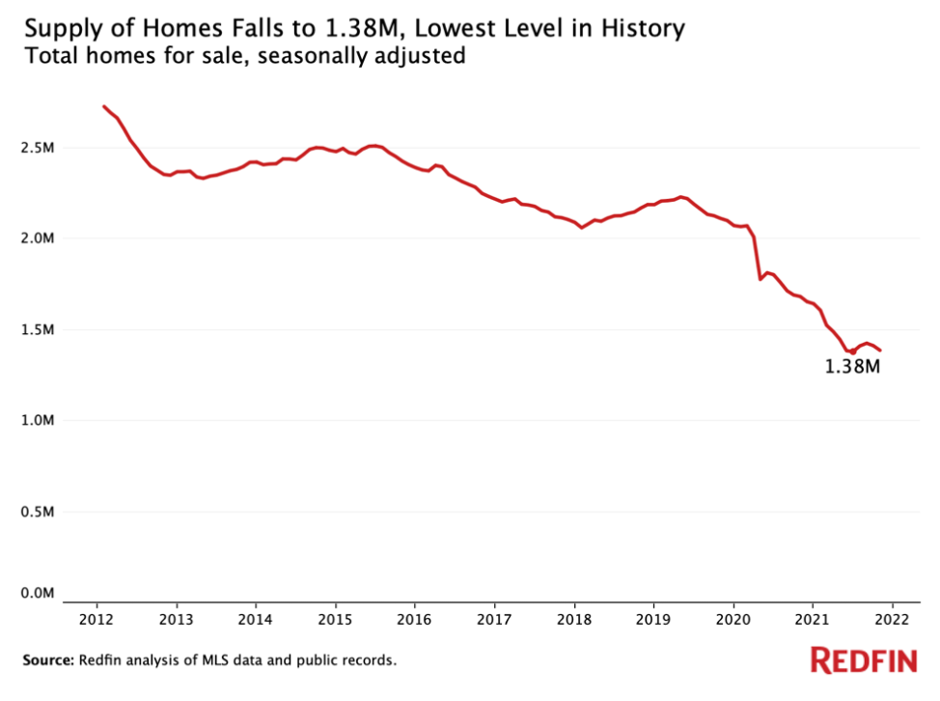


Slide 8
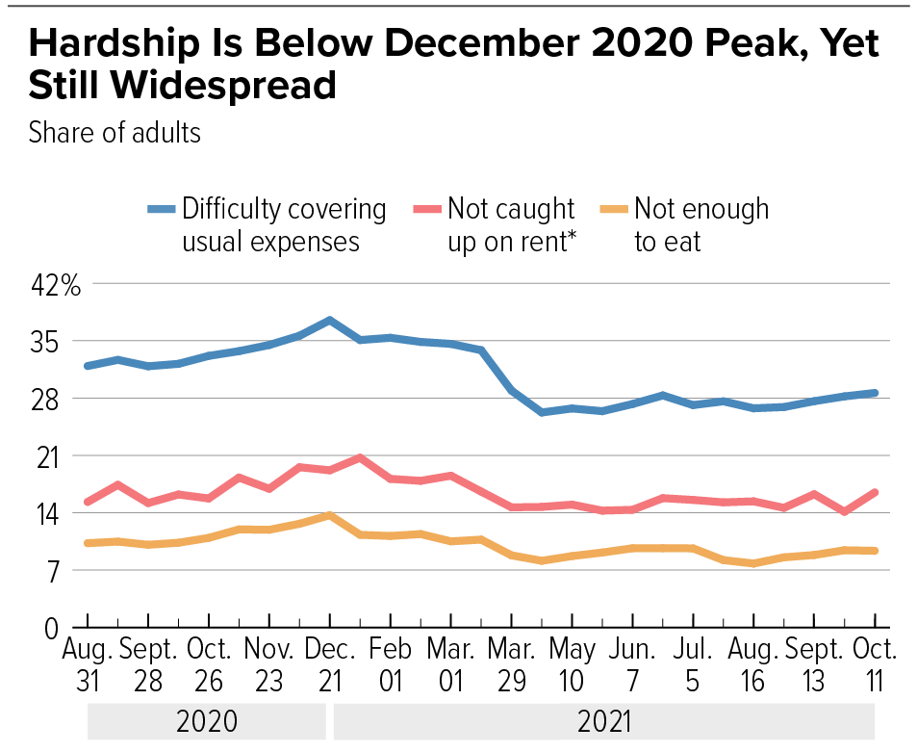
Source : CBPP analysis of Census Bureau Household Pulse Survey tables

Slide 9
INFLATION

Slide 10
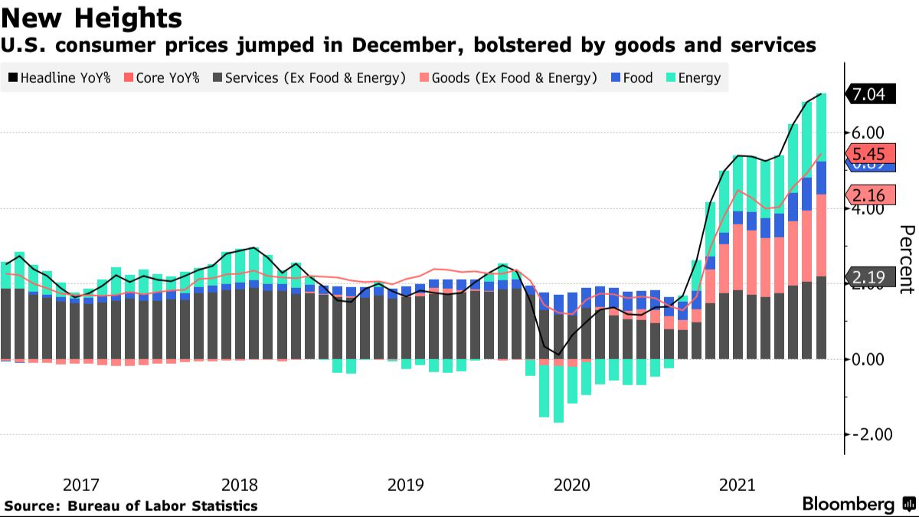

Slide 11
I DON’T KNOW

Slide 12
How I will find my answers
Primary : Interviews with colleagues and friends that have been impacted by the housing problems. Potentially have an interview set up with a real estate agent.
Secondary : Articles and journals showcasing statistics about pre-covid to present time. Look for documentation on what caused the housing costs to skyrocket.

Slide 13

So What?

Slide 14
Sources
Parrott, Sharon, et al. “Tracking the COVID-19 Economy's Effects on Food, Housing, and Employment Hardships.” Center on Budget and Policy Priorities, Center on Budget and Policy Priorities, 10 Nov. 2021, https://www.cbpp.org/research/poverty-and-inequality/tracking-the-covid-19-economys-effects-on-food-housing-and#:~:text=The%20majority%20of%20jobs%20lost,of%20Labor%20Department%20employment%20data (Links to an external site.). Accessed 28 Jan. 2022.
https://www.istockphoto.com/photo/house-and-money-gm185121887-19551430
https://www.vectorstock.com/royalty-free-vector/not-for-sale-rubber-stamp-vector-12439987
https://www.redfin.com/news/housing-market-records-2021/
https://www.bloomberg.com/news/articles/2022-01-12/inflation-in-u-s-registers-biggest-annual-gain-since-1982

